Slide 1
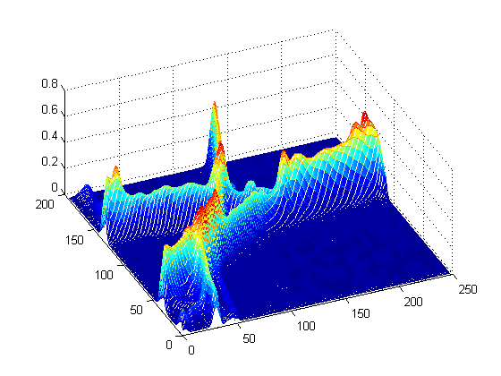

Slide 2



$$e_{3}$$
$$e_{2}$$
$$e_{1}$$

